Slide 1
Movie Revenue Tracker
A Regional and Temporal Box Office Analysis
NAME : Sandeep chattar
Institution: IIT Patna

Slide 2
Problem Statement
Can we compare box office collections of different movies across regions to uncover performance patterns based on genre, language, and release timing?

Slide 3
Project Objectives
- Analyze movie revenues across regions
- Track performance trends by genre and language
- Visualize weekly revenue performance
- Support release strategy optimization

Slide 4
Dataset Overview
- Movie Name
- Region
- Release Week
- Genre
- Language
- Revenue
- Release Date

Slide 5
Methodology
1. Import movie revenue dataset
2. Data cleaning and transformation
3. Group by movie, region, and week
4. Visualize collections and trends
5. Add filters for genre and language

Slide 6
Tools and Technologies
- Python (Pandas, Matplotlib/Plotly)
- Power BI / Tableau
- GitHub for version control

Slide 7
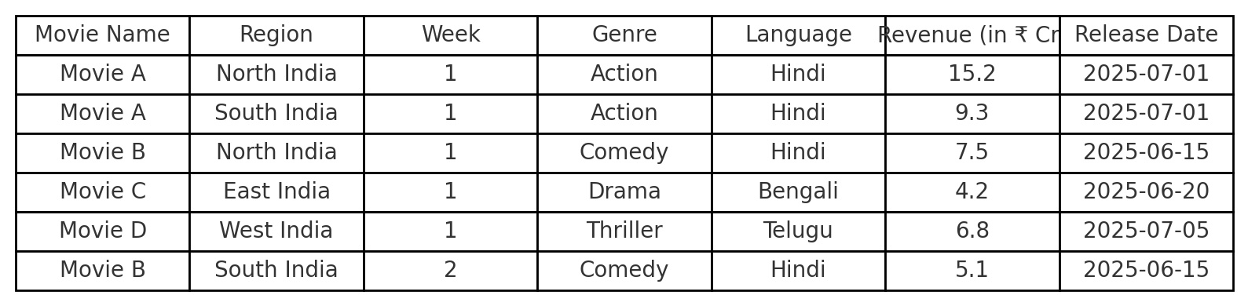
Sample Data Snapshot

Slide 8
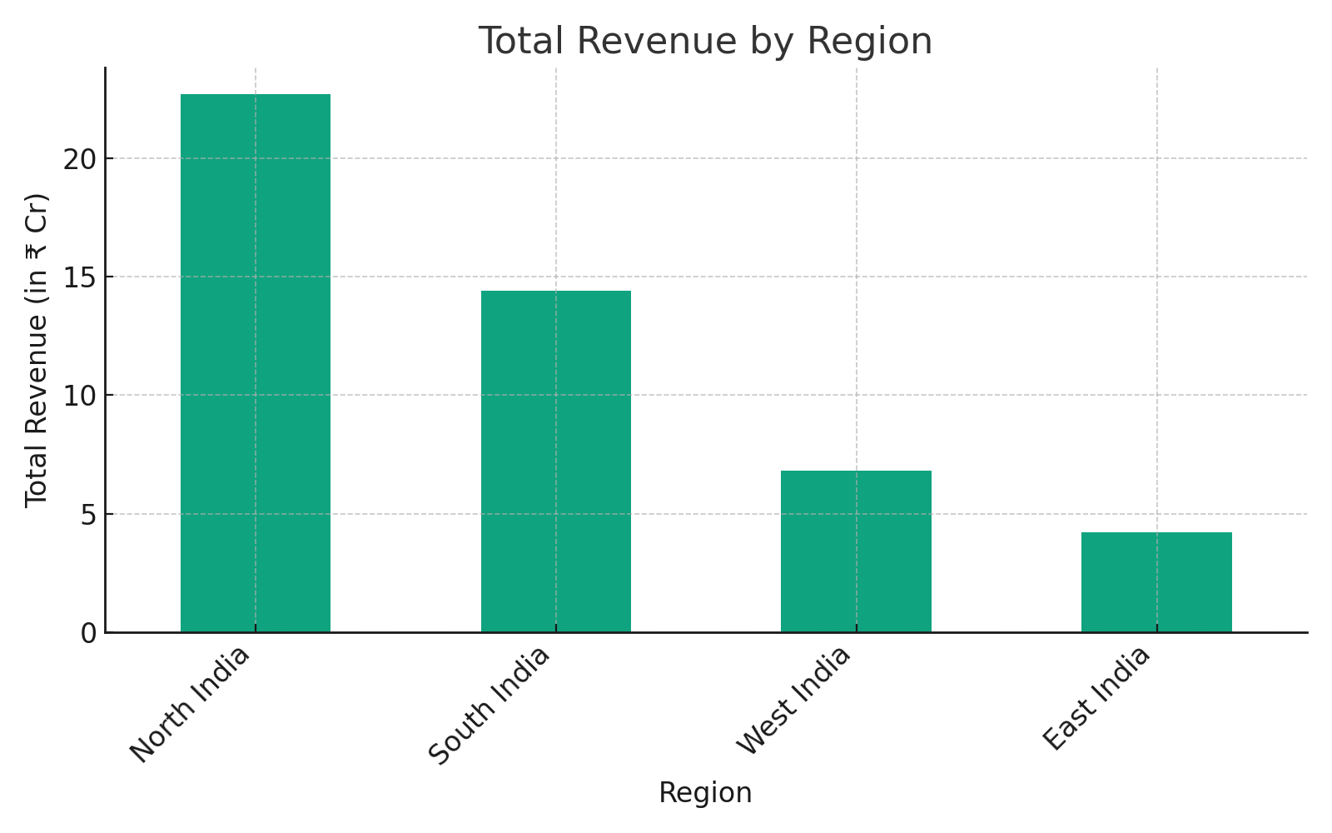
Revenue Comparison - Regions

Slide 9
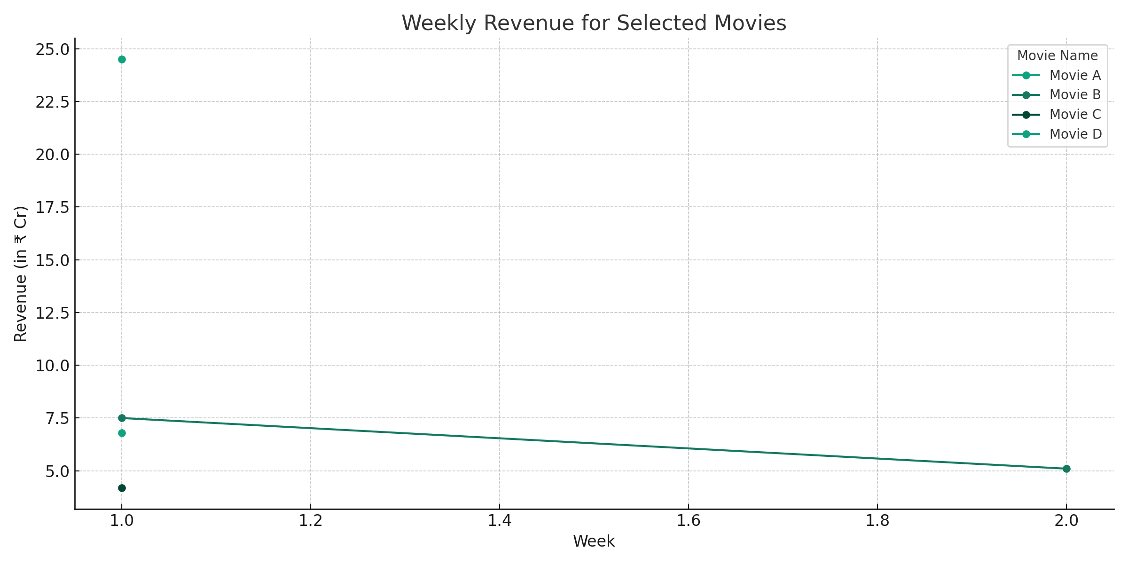
Weekly Revenue Trends

Slide 10
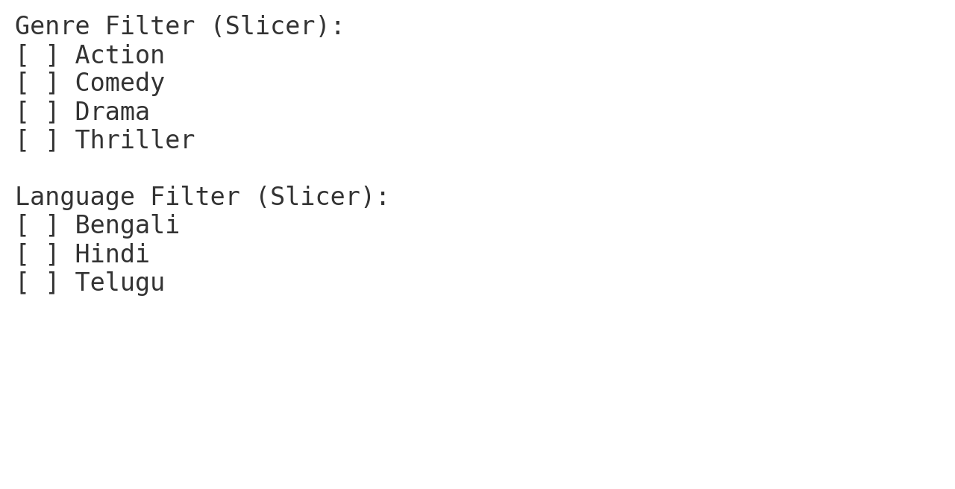
Interactive Filtering

Slide 11
Current Progress
- Dataset cleaned and loaded
- Initial charts created
- Dashboard under development

Slide 12
Next Steps
- Finalize dashboard visuals
- Add user interactivity
- Publish and document GitHub repo

Slide 13
GitHub Repository
Link: https://github.com/yourusername/movie-revenue-tracker
Make sure the repository is public and includes:
- README.md
- Code files and scripts
- Presentation file

